Slide 1
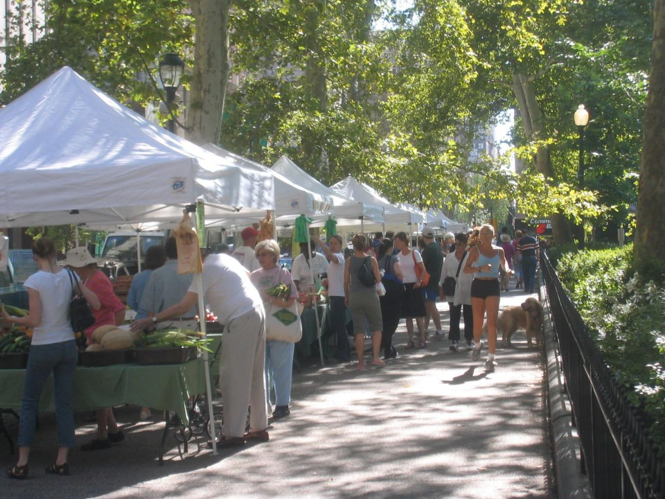
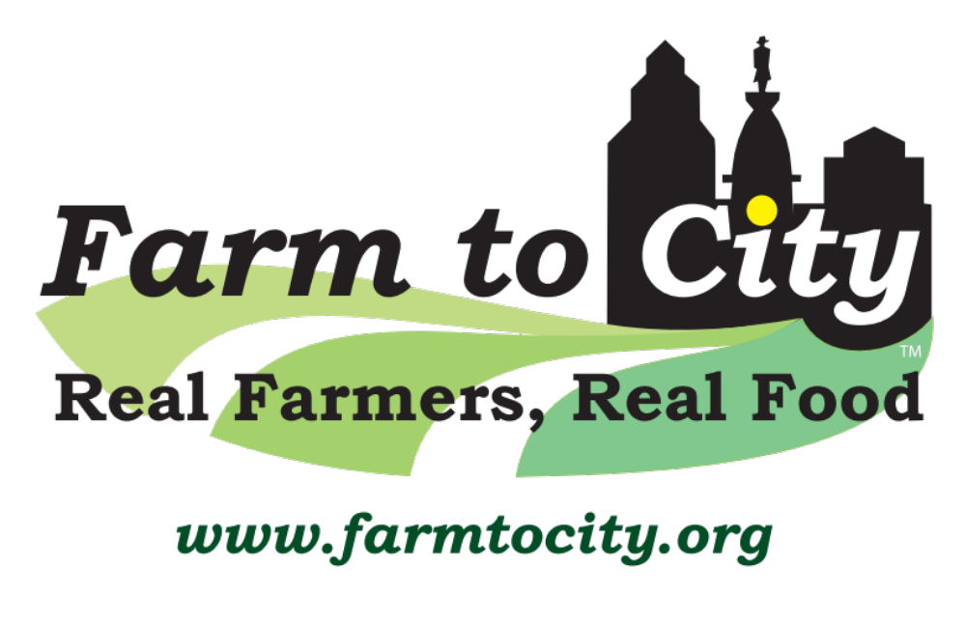
Farmers’ Market Program

Slide 2
Farm to City
Mission: is to unite communities, families, and farmers year-round through good locally grown food.
Slogan: Real Farmers, Real Food
Notes:
Farm to City is a Philadelphia-based program whose goal is to unite communities, families, and farmers year-round through good locally grown food.
since 2001
Farm to City envisions a city connected to its region through its farmers and their crops, a city rich with healthful and flavorful food choices - at outdoor markets, grocery stores, restaurants and schools.
Farm to City sees a region where the sustainable family farm is economically successful and a force to preserve our vanishing countryside.
Values
Community
Health
Reliability
Quality
. . . And Trust
But – no farmers, no food. So our mission tells us that our clients are farmers.
In 1996, some friends of mine and I in the South Street area of Philadelphia started the South & Passyunk Farmers’ Market with four farms. When we looked up, we realized that the South &Passyunk FM was the only outdoor farmers’ market in Philadelphia.
That fall I was hired by the Food Trust as its director of community markets. In the three plus years I was there I started seven markets for the Food Trust. I left there in 2000 over a policy difference. The Trust’s mission is to get affordable food into neighborhoods in distress – low income. I realized that this mission is nearly impossible since the many of the farmers I worked with were low income themselves and couldn’t afford to sell the food they produced at prices low enough for low income buyers. So I moved on to start Farm to City. In 2000 I designed the logo, got my daughter Daniela be my bookkeeper, and then planned for startup in 2001 with three programs.
1. Farmer’s Markets (5)
2. CSA support: I helped farms find members – this Is the box-of-produce-a-week program
3. Winter Harvest Buying Club – on-line buying, delivery to 15 locations in and around Philadelphia.
Then in 2005, started Web Services: allowed others to use our website for
Farmer Choice CSA member recruitment
Member Choice CSA member recruitment and member Use
Buying Club management

Slide 3
Values: Respected and Projected
Advocate for Small Farms
Local Food
Fresh Food
Healthful Food
Tasty Food
Slower Pace Shopping and Easting
Families
Green
Trust

Slide 4
Business Values
Our clients are: primary producers, then food artisans
Reliability
Health
Community
Quality
Trust

Slide 5
Programs
1. Farmers’ Markets (2001 to present
2. Winter Harvest (2001 to 2017)
3. Recruitment Service for CSA farms (2017 to 2018)
Web Service to other Buying Clubs and CSA farms (2005 – present: hangin’ by a thread).
Notes:
Now, how has Farm to City done in serving its client?. Although there are other valid ways to measure our success, none is more direct than economic success.
Farm to City is now in its 14th year of operations. We have kept careful records of sales by producers – farms and value added food businesses – across these years. Here is what it looks like.

Slide 6
Total Sales by Producers in Farm to City Programs
From 2001 to 2013
Notes:
Each year since we have added an average of $3.8 M more for an 18 year total of approximately $38M

Slide 7
Farm to City Staff
Bob Pierson, Director and Owner (part time)
Jon Glyn, Manager of Farmers’ Market Program
Seasonal market site managers (6-8 part time)
Bookkeeper/accountant (contractor, 5 hrs/wk)

Slide 8
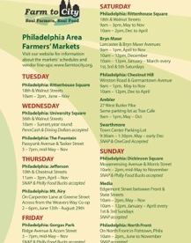

Slide 9
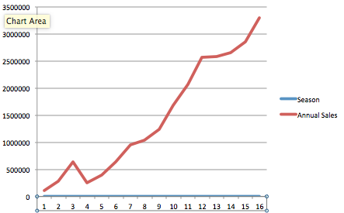
Sales by Producers in Farm to City Programs – 2001 to 2016
Notes:
Finally our farmers’ market program. Steady growth over the past 14 years.
Note the blip in 2002-03. Why?
Also 2013. should be higher but we are still waiting for sales reports from several producers.

Slide 10
Survey Results:
Rittenhouse Market 2005

Slide 11
Miscellaneous
Season
Market days
Market rules
Market management
Market promotion
Sources of income
Notes:
May through November
Several year-round
Dedicated crew market managers who are around during set up, . Managers at our larger markets are there the whole time.
Market promotion, mainly by social media; some use of posters, leaflets, and banners. When we pooled market we found that’

Slide 13
Blueprint: The Evolutionary Origins of a Good Society
Nicholas A. Christakis. Little, Brown Spark, $30 (496p) ISBN 978-0-316-23003-2.
Published mid-March, 2019.
Christakis (Connected: The Surprising Power of Our Social Networks and How They Shape Our Lives), a Yale professor of social and natural science, proposes that the human capacity for cooperation and empathy derives from an “evolutionary blueprint for making a good society” possessed by everyone. Setting himself against scientists focused on aggression and selfishness as the “dark side of our biological heritage,” Christakis lays out what he considers powerful evidence that biology—not socialization—is ultimately responsible for good deeds. He begins by analyzing how social structures developed among survivors of shipwrecks, extreme circumstances

Slide 14
that he treats as real-world experiments. Reviewing dozens of such cases leads Christakis to conclude that these survivors did not “invent wholly new sorts of effective social order,” but followed an evolutionary playbook. His book’s scope also includes other species, including primates and elephants, known to exhibit altruism and self-sacrifice, and massive online gaming communities. Not every reader will come away persuaded of Christakis’s thesis that the “arc of our evolutionary history is long” but “bends towards goodness.” Nonetheless, his thoughtful and comprehensive analysis, a valuable complement to Steven Pinker’s similarly themed The Better Angels of Our Nature, provides much food for thought and a refreshingly optimistic perspective.

